Slide 1
Do International Rankings Affect Public Opinion?
Amnon Cavari, Asif Efrat, and Omer Yair
Institute for Liberty and Responsibility
Reichman University
May 2024

Slide 2
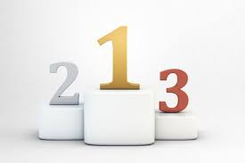
Motivation for the Study
Growing interest in rankings and their policy impact; policymakers seem to care about rankings for reputational reasons
But we know little on how the public perceives rankings
Studies of shaming’s impact on citizens reached mixed results
Analyzing two issue-areas jointly

Slide 3
Do Citizens Care about Rankings?
Rankings allow citizens to overcome informational limitations in assessing policy; provide an outsider’s view
Rankings capture citizens’ attention: simple, fuel competition, media coverage
Governments are attentive to public views, even if marginally, and especially on policies that matter to them (education, environment)
OECD Ranking of Environment Protection

Slide 4
Research Question
What is the effect of international rankings on public perceptions of government policy and public demand for policy improvement?

Slide 5
Potential Public Response to Poor Rankings
View negatively the performance of their country on the issue
Support efforts to improve the performance of their country on the issue
Willing to take political action to demand improvement of government performance on this issue

Slide 6
H1a: Citizens are more likely to evaluate the performance of their country as better when the country receives a high ranking, compared to when it receives a low ranking.
H1b: Citizens are less likely to support efforts to improve the performance of their country when the country receives a high ranking, compared to when it receives a low ranking.
H1c: Citizens are less willing to take political action in demand of improved policy performance when the country receives a high ranking, compared to when it receives a low ranking.

Slide 7
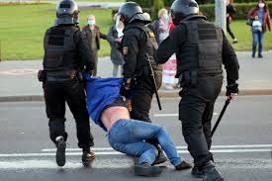
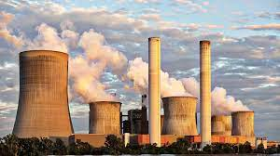
Variation in the Impact of Rankings
H2: Rankings would have a weaker impact in areas where the public is polarized
H3: Rankings would have a stronger effect when they come from a trusted, unbiased source

Slide 8
Variation in the Impact of Rankings
H2: Rankings would have a weaker impact in areas where the public is polarized
H3: Rankings would have a stronger effect when they come from a trusted, unbiased source

Slide 9
Israel as the Site of Analysis
Expectation: Rankings more strongly affect Israelis on the environment, compared to human rights
Expectation: Rankings published by the U.S. government more strongly affect Israelis compared to rankings from IOs and NGOs
Across 19 rich countries surveyed by Pew (2022), Israelis held the most negative view of the UN; more positive view of the U.S.

Slide 10
Methodology
Survey experiment among 4,016 Israeli respondents
Three factors:
Source: U.S.; OECD; NGO (U.S. is more trusted)
Issue area: human rights; environment (human rights is more polarized)
Rankings: 14th (high); 78th (low)
Measures: Israel’s performance is good; more government efforts; petition signing
Pretreatment measures as a baseline (satisfaction with government functioning)

Slide 11
H1: Effect of a high ranking on evaluation, preference, and action

Slide 12
Pretreatment items, compared to the DV

Slide 13
H2: Testing for variation between issue areas (polarized vs.
non-polarized)

Slide 14
Predicted values of the tests of H2

Slide 15
H3: Testing for variation across sources of rankings (U.S. vs.
IO/NGO)

Slide 16
Conclusion
Results partially conform to expectations: high rankings result in a more favorable evaluation of policy; poor rankings are dismissed
Self-enhancement theory: people wish to increase positivity of self-view
Backlash against poor ranking on human rights, despite the gentle nature of criticism

Slide 17
Ranking source matters little: people accept positive messages from any source
Rankings may not achieve the intended impact on the public
Israelis are likely not unique in their attitude toward rankings

